Slide 1

Identifying security risks - from theory to practice

Slide 2
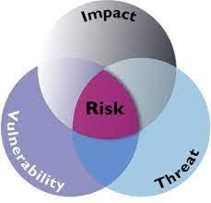
About the security risks
Definitions: The risk to organizational operations (including mission, functions, image, reputation), organizational assets, individuals, other organizations, and the Nation due to the potential for unauthorized access, use, disclosure, disruption, modification, or destruction of information and/or information systems.

Slide 3
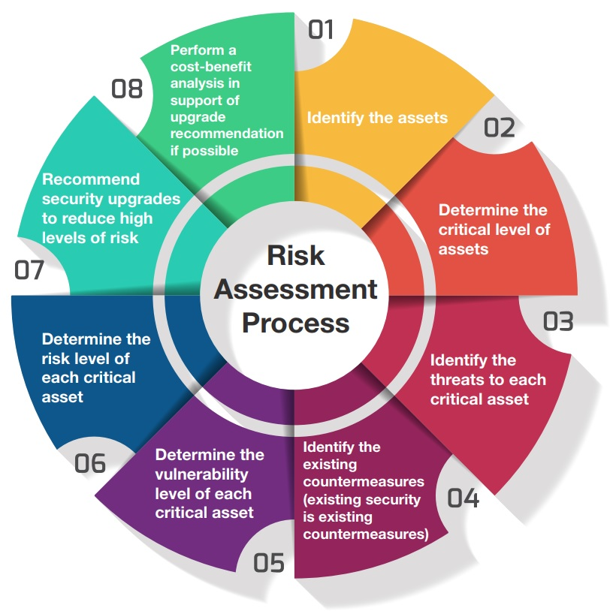
Steps in a Security Risk Assessment
Identify and prioritize assets.
Identify threats.
Identify vulnerabilities.
Analyze existing controls.
Determine the likelihood of an incident.
Assess the impact a threat could have.
Prioritize the risks.
Recommend controls.

Slide 4

PHYSICAL SECURITY RISK ASSESSMENTS
Develop a plan and define its scope. ...
Identify threats and vulnerabilities. ...
Assess impact and likelihood. ...
Review the current state of your physical security. ...
Implement or update mitigation measures. ...
Establish a regular cadence for reassessment.

